Slide 1



Autonomous Agents Networks
An LF Edge Akraino Blueprint, Under the Physical AI Blueprint Family
v0.3, Jan 2026

Slide 2
Contents
Overview
AAN is an Akraino LF Edge blueprint
agents, machines, and interaction
Motivation
autonomous agents are the next industrial revolution
prioritize communication, collaboration, and human safety
Agent-Agent Interaction
use cases
cloud independent
Human-Agent Interaction
use cases
safety is a primary concern
Capabilities Advertisement and Action
teamwork and collaboration
action history and logging
Key Technologies
P2P communication over cellular and satellite networks
small multimodal models
human interaction - audio and visual
environmental recognition – hazards and dangerous conditions
small form-factors pose performance challenges
Technology
small form-factor hardware
architecture and data flow
Messaging
Models
data storage
authentication
Software Components
ASR – Whisper, Kaldi
frameworks and toolsets – OpenCV, OpenVINO
packet / media pre- and post-processing – Mediashark
small multimodal models – Llama-4, Gemma 3, Qwen2, MiniPCM

Slide 3
Overview – Autonomous Agents Networks Blueprint
AAN is an LF ¹ Edge Akraino blueprint
AAN is a member of the Akraino “Physical AI” blueprint family
Autonomous agents
are robots, drones, automated vehicles, factory, environmental, and mobile sensors
interact with each other and with humans
cloud independence and human safety are primary objectives
underlying technologies are AI and telecom
Initial use cases
Industrial Collaboration
Flood Detection, Prediction, and Rescue
First Responder Machine Assistants
¹ Linux Foundation

Slide 4
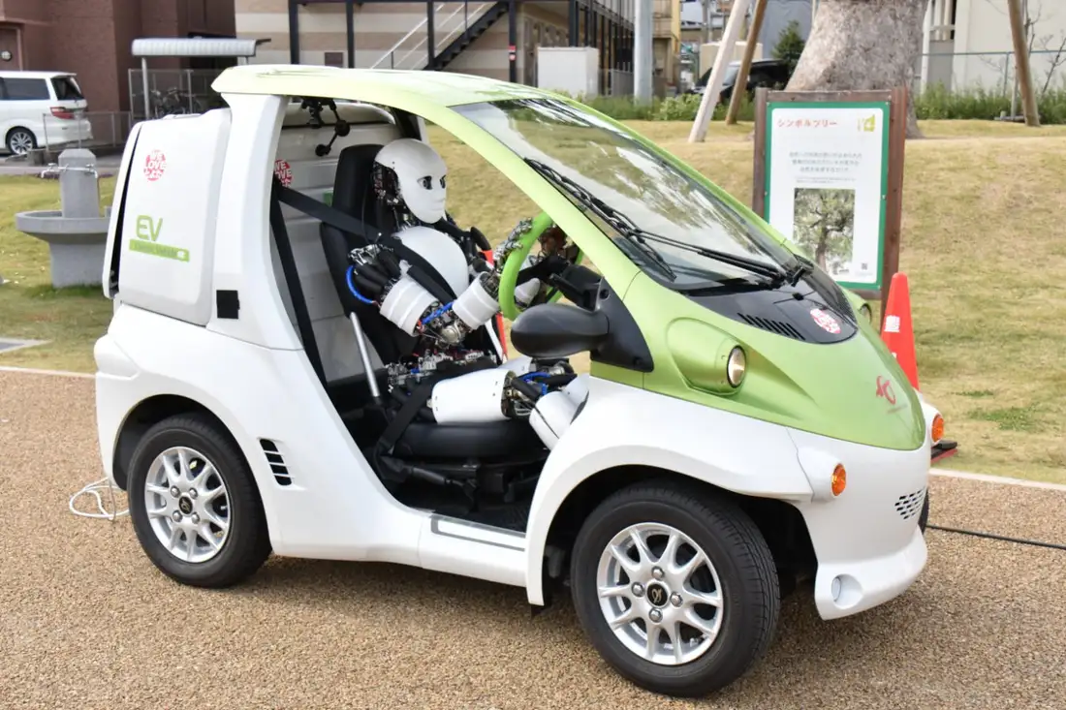
Overview – Agents, Machines, and Interaction
“Agents” vs “Machines”
agents imply autonomy, goal-orientation, and ability to learn and adapt
AAN is about physical agents
as agents become more flexible, like humans they will be separate from machines, for example a car might have a humanoid driver (even if the car has its own automation)
there is some risk of confusion in using the term “agents”, as “machines” will inevitably become a popular term
specific use cases may refer to “machines”
“Interaction” includes …
bi-directional communication, feedback
fundamentals of collaboration – situational awareness, reaction, teamwork
agent-agent interaction includes “M2M” standards and protocols (machine-to-machine communication)
Car with humanoid driver, Univ of Tokyo, Kento Kawaharazuka

Slide 5
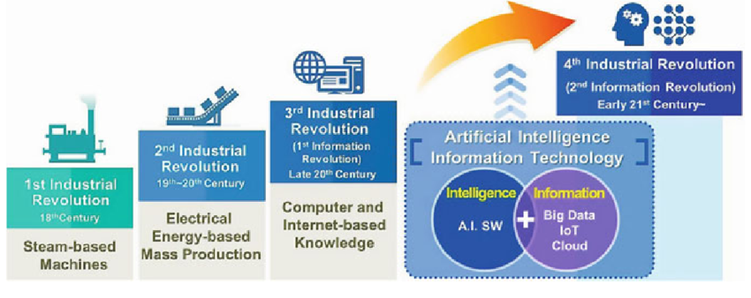
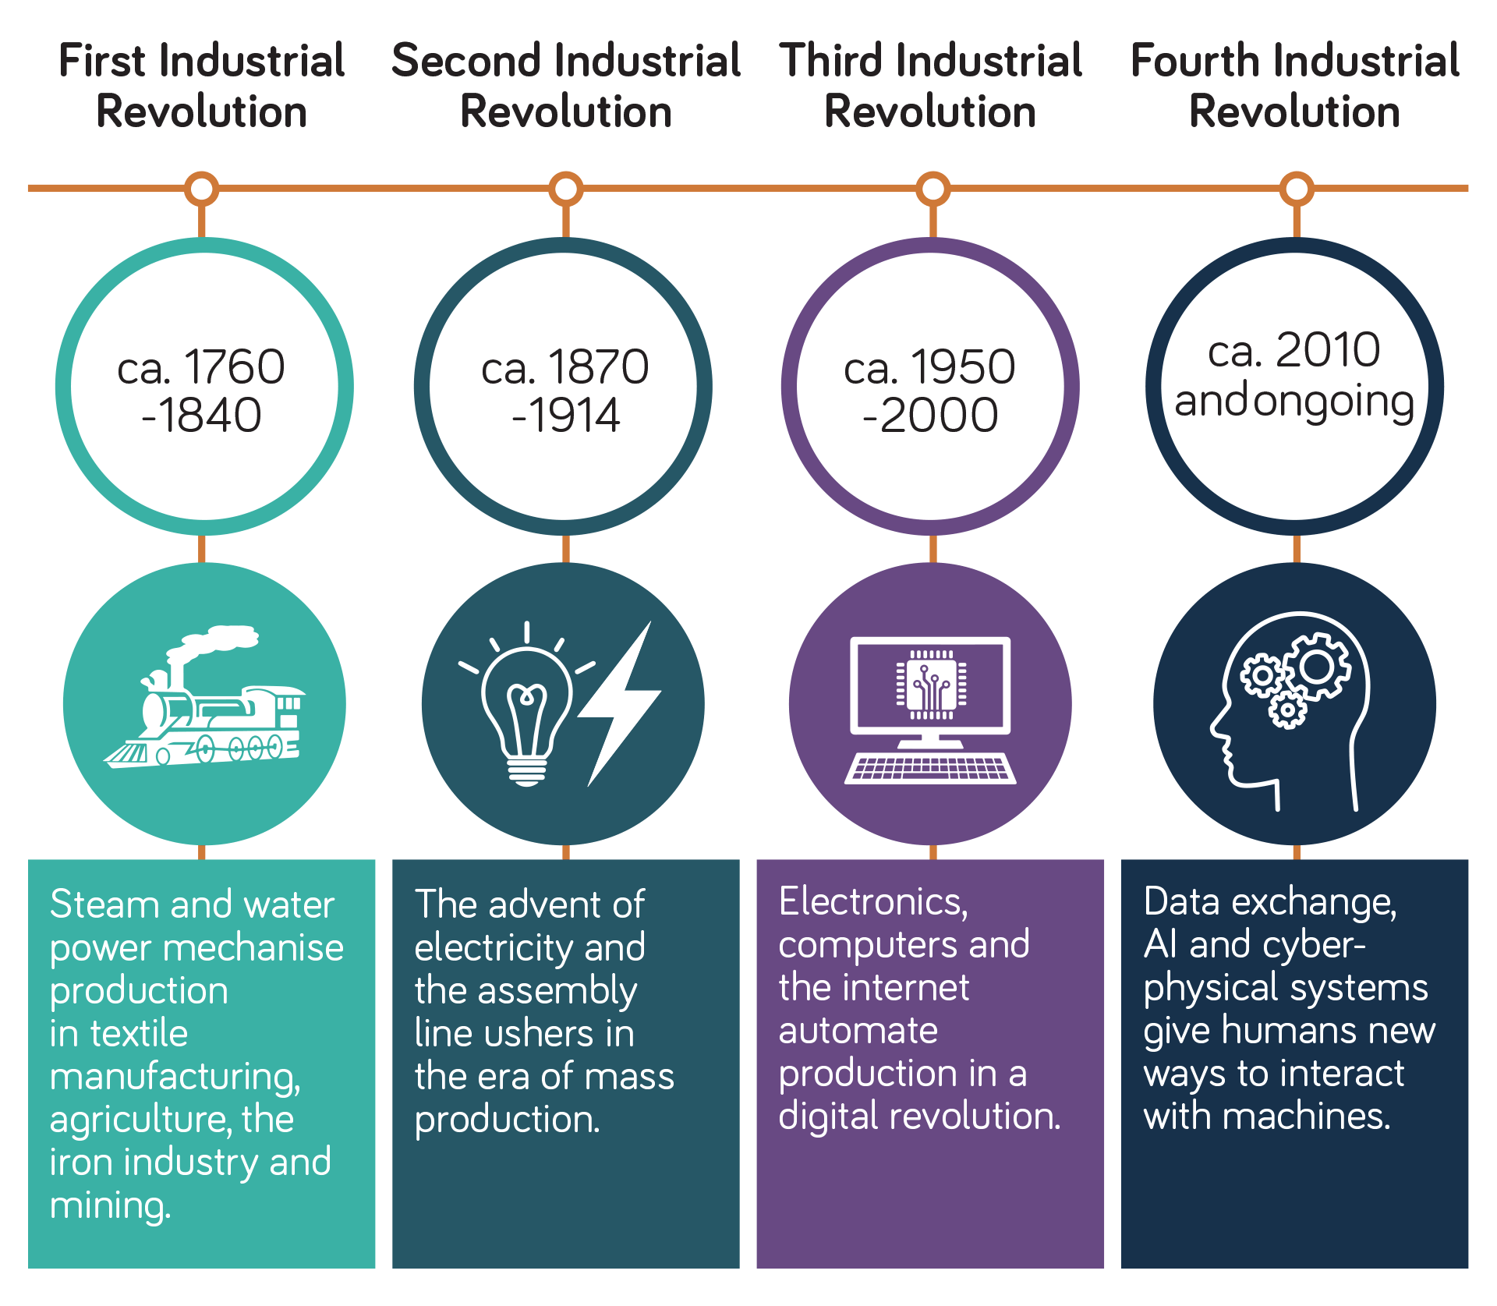
Motivation
In the next industrial revolution millions of agents must …
collaborate with each other and with humans
operate fully autonomously, with intermittent cloud connectivity when available
expectations of always-available cloud connectivity are unrealistic, expensive, not secure, energy hungry – and most importantly – unsafe
power outages should not immobilize AVs in the streets ², forklifts in factories, robots helping elderly patients
maximize energy efficiency, distributed intelligence, teamwork
as demonstrated by evolution
Agent teamwork and human safety are top priorities
human safety is the most difficult challenge
teamwork leads to better decision making – “another set of eyes”, collective experience
open source software, small form-factor hardware, new DNN¹ training methods, and 3GPP and IEEE P2P communication standards are areas of emerging R&D and innovation
BigAI business models and “incompatible moats” are problematic
they make less money when intelligence is decentralized
not their top priority
more difficult to recruit BigAI contributors to telecom and edge-centric blueprints
4th Industrial Revolution is the 2nd Information Revolution [Surajudeen Abiola Abdulrahman, MD, MHPM, PhD, National Health Service, UK]
¹ Deep Neural Network ² https://gizmodo.com/blackout-in-san-francisco-litters-streets-with-traffic-blocking-deactivated-waymos-2000702290
4th Industrial Revolution includes human interaction with digital devices [Neos Networks, https://neosnetworks.com/resources/blog/what-is-fourth-industrial-revolution-4ir]

Slide 6

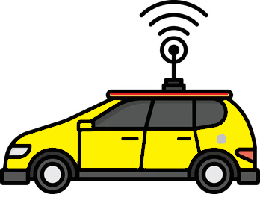

Agent-Agent Interaction
LoRa / HaLow
LoRa / HaLow
Industrial use cases
manufacturing
mobile delivery and roadside (e.g. cleaning, driver assistance)
construction
agriculture
P2P (peer-to-peer) communication
inter-agent (direct) using PC5 sidelink, HaLow 802.11ah, LoRa+LoRaWAN, DSRC¹ IEEE 802.11x
relay via cellular and satcom networks using C-V2X and PC5-NTN relay
multicast to other agents in close proximity
high MHz to mid GHz bands
free spectrum bands, for example band formerly used by cordless phones
C-V2X and DSRC use ITS ² spectrum
sometimes known as “mobile WiFi”
short, low-power, codified emergency and safety messages
optional text and low bitrate audio and video, depending on agent compute capacity
PC5 Relay
PC5 Sidelink
PC5 Relay
¹ Dedicated Short Range Communications ² Intelligent Transportation Systems, 5.9 GHz band

Slide 7




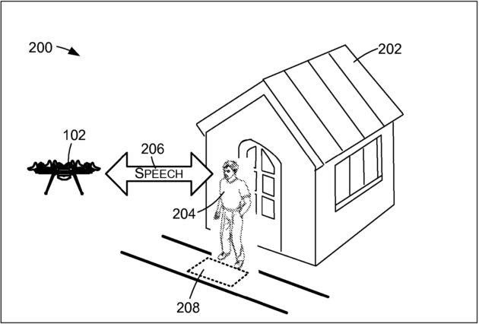
Human-Agent Interaction
Use cases
flood prediction, detection, and rescue
first responder machine assistants
proximate machine safety
Audio and visual interaction
small multimodal models recognize natural human speech and gestures
apps supported but not required, we assume unreliable or unavailable cloud connection
very small form-factor devices (e.g. pico ITX, mini ITX; see Small Form-Factor Hardware slide for examples)
background and ambient noise, urgent or stressed voice input, vernacular (“Yo, forklift”), and multiple talkers
machine noise from servo motor and other mechanical sources
Drawing excerpt from Amazon delivery drone patent (see Supplemental slides for more information)

Slide 8
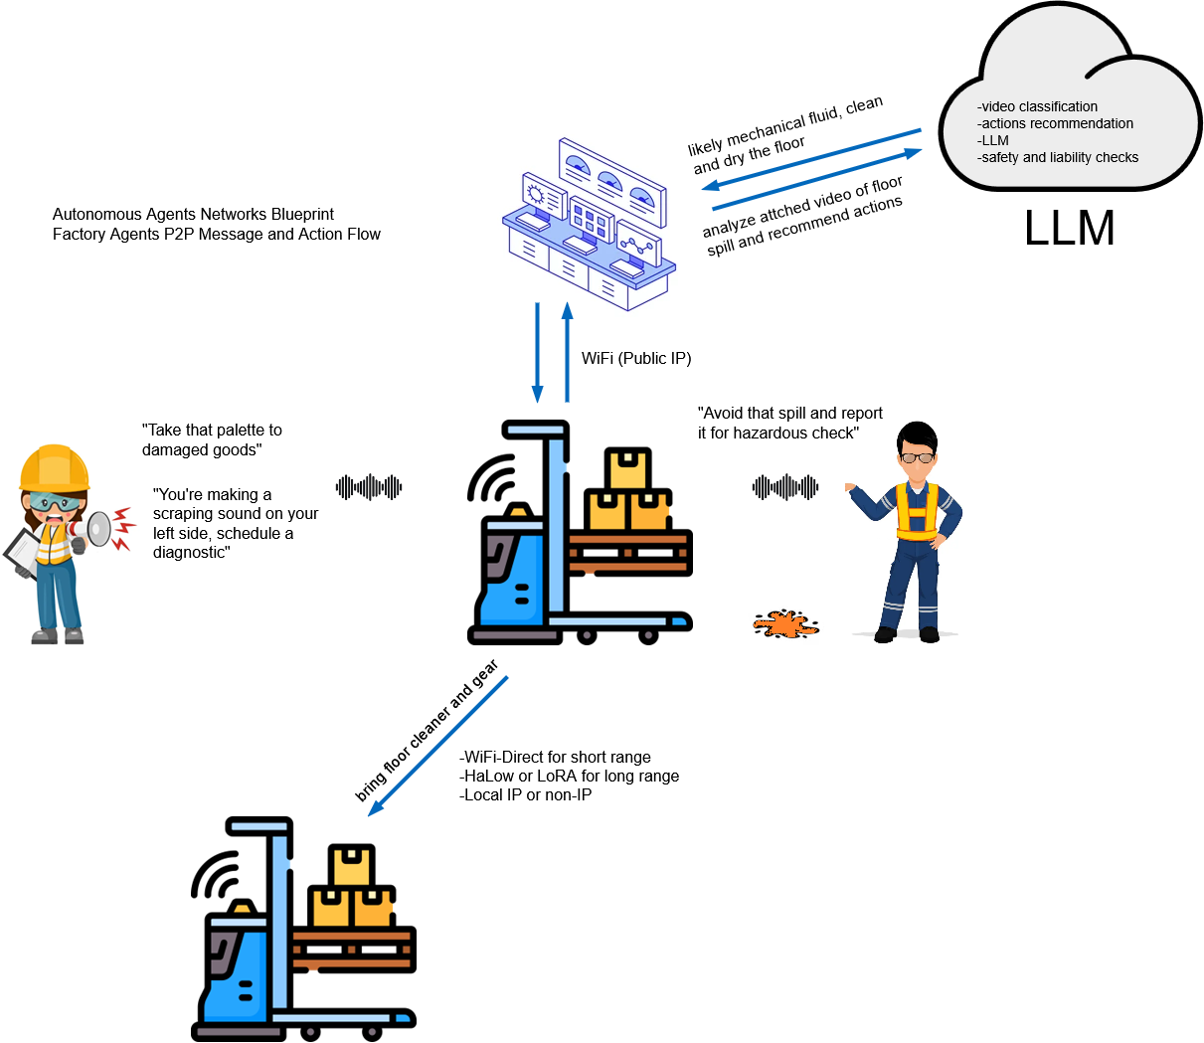
Agents Advertise and Act Based on Capabilities
Agents advertise APIs and services for …
language and multimodal models
data storage and database
authentication
Agents work together to overcome disparate capabilities
as an example, an agent may have limited on-device gesture recognition but is unable to analyze complex images
worst case they can only record video and audio
on-device AI and autonomous operation are the default when possible
cloud AI is used when necessary and available
Human interaction is key to handle situations that are
ambiguous
urgent or unsafe
expert guidance needed
Agents act on P2P messages based on 1) Action field contents and 2) match with their capabilities
action field maintains history of transmission chain
actions are logged for reports and telemetry
“Collaborative M2M messaging” and “content aware networking” are similar concepts
WiFi
Factory agents message and action flow

Slide 9
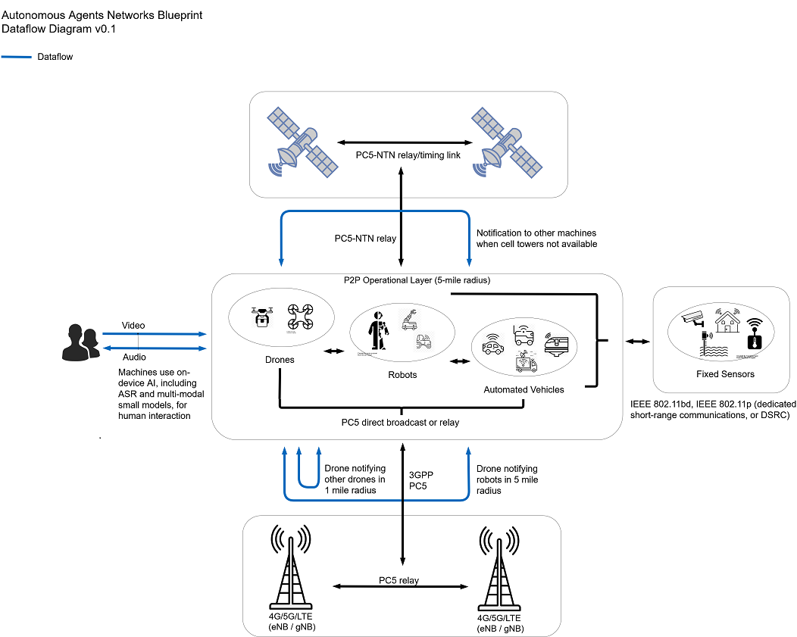
Key Technologies
Telecom
P2P communications between agents, relay over cell and satellite networks
short, energy-efficient, machine-readable messages prioritized by human safety, commercial need, machine failure, etc
local IP, non-IP
AI
small multimodal models, recognizing …
speech
behavior and gestures
hazards and dangerous conditions

Slide 10
Technology Challenges
Severe SWaP ¹ constraints
small size, especially in drone and consumer applications
low power consumption, posing a technical challenge for communication and small multimodal models
weight is limited and may have less obvious consequences, for example GPU use may be limited due to heatsink or liquid cooling requirements
Model performance and accuracy
limited number of CPU cores
Data storage
dedicated storage nodes may be required
Authentication
authenticating human-agent interaction expected to be extremely difficult problem
potential risks include 1) “spoofing”; i.e. humans giving agents fake or harmful instructions and 2) physical obstruction or damage to agents
agent-agent authentication
¹ Size, weight, and power consumption

Slide 11
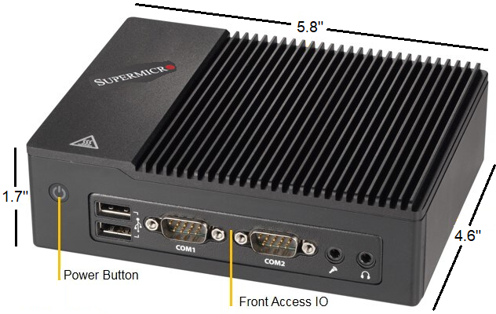
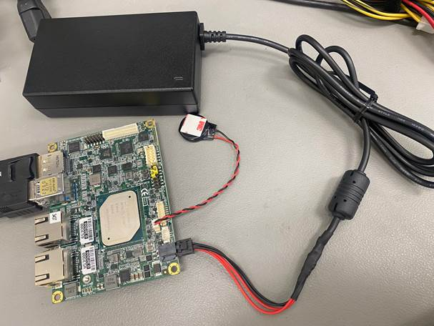
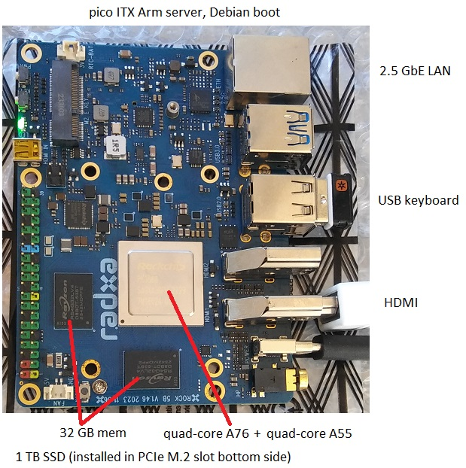
Small Form-Factor Hardware
Supermicro quad-core x86 server, 8 GB RAM, 2 TB SSD, WiFi
Very small form-factor
pico ITX and mini ITX motherboards
under 15 W, battery powered for 2 - 6 hours
4 x 3”, heat sink only, no fans
Operate as small servers
standard Linux OS (Ubuntu, Debian, etc) and command line
gcc/g++, Python, JavaScript, other standard development tools
open source support for multimodal models, communication protocols, media frameworks
connect keyboard and display for lab or field test / debug
Pico ITX quad-core Atom x86 server, Ubuntu boot
Pico ITX 6-core Arm server, Debian boot

Slide 12
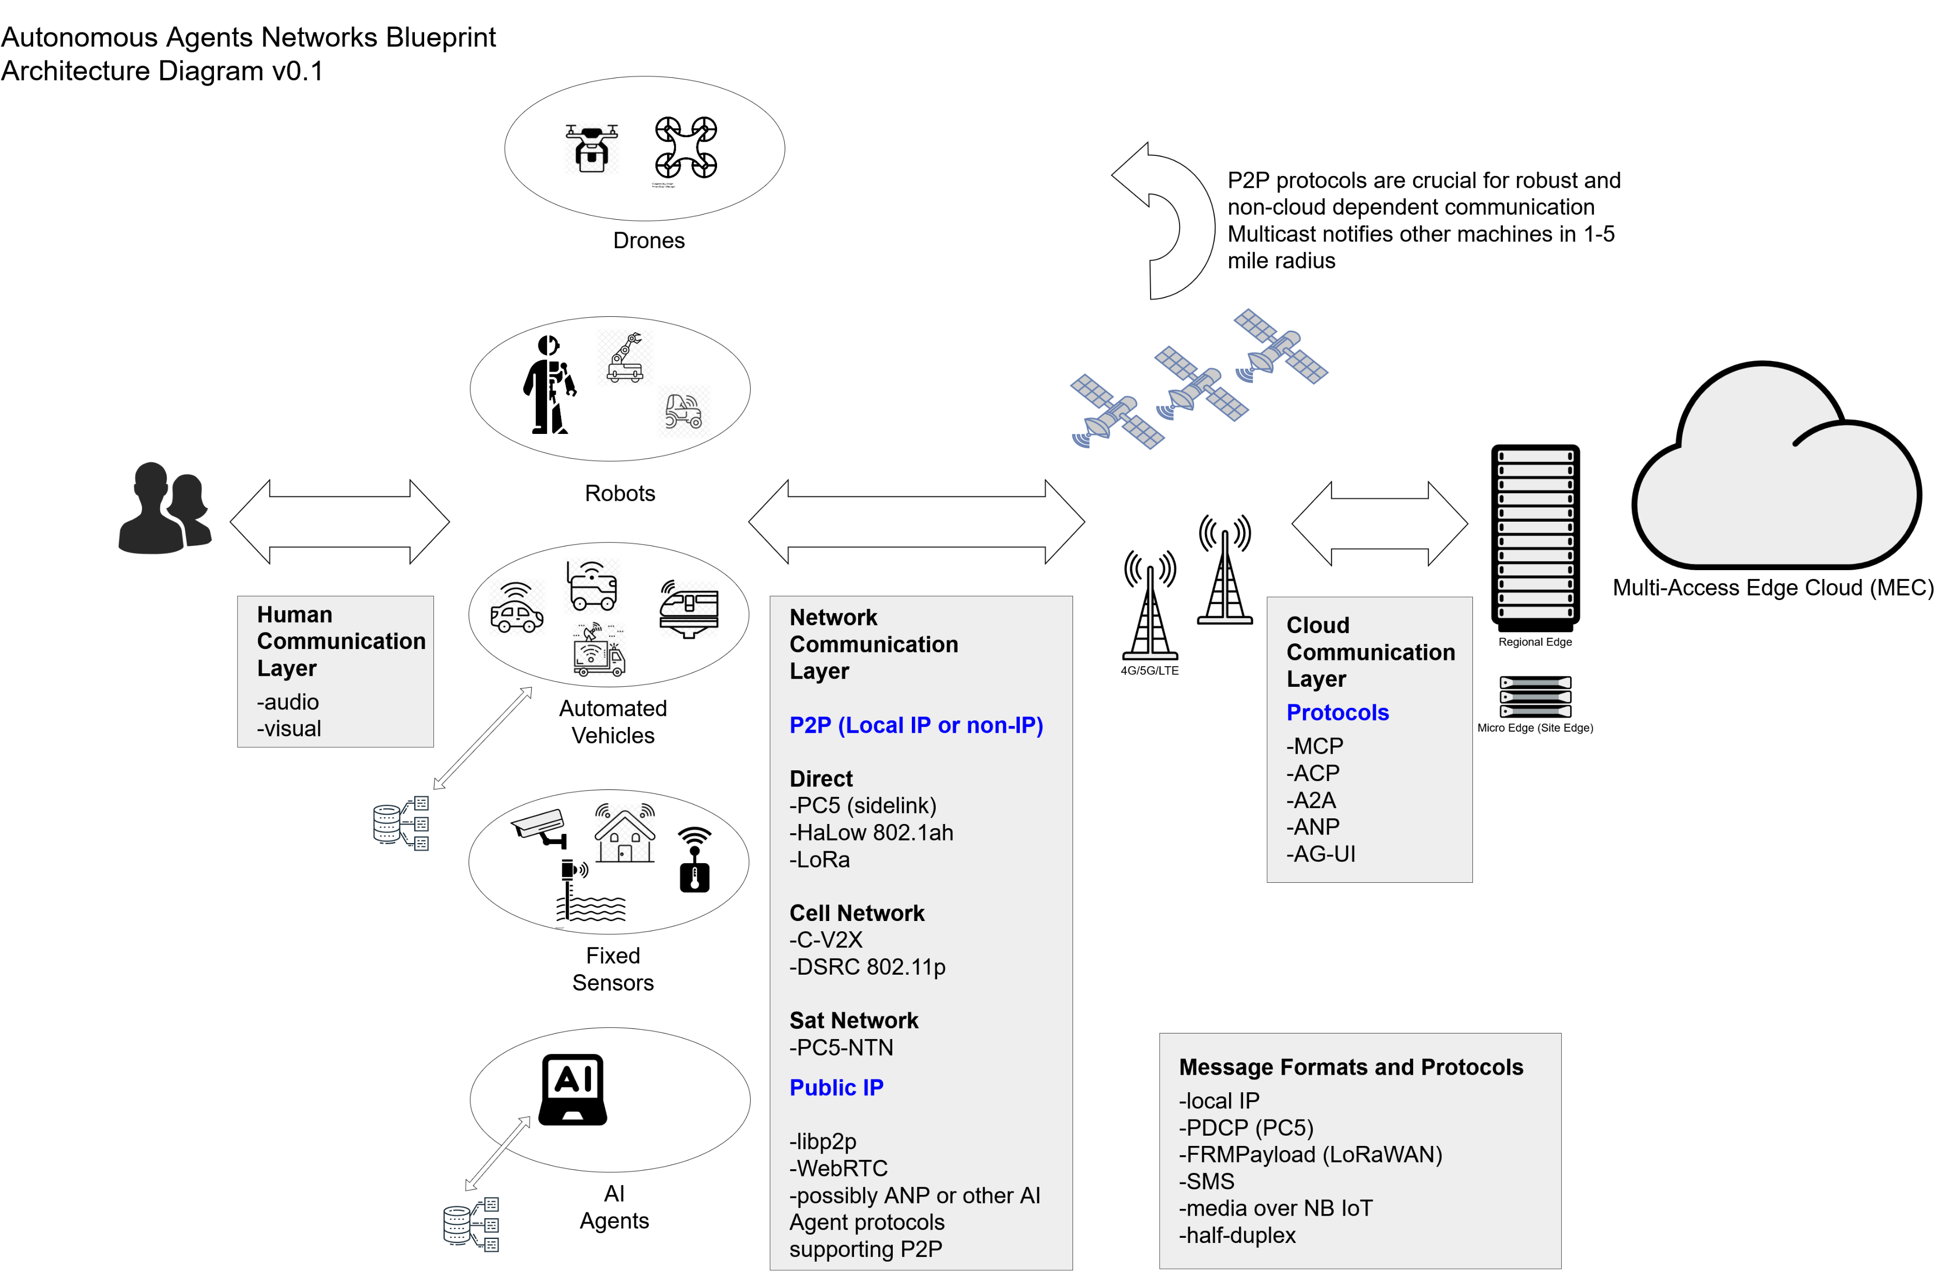
Communications Architecture

Slide 13
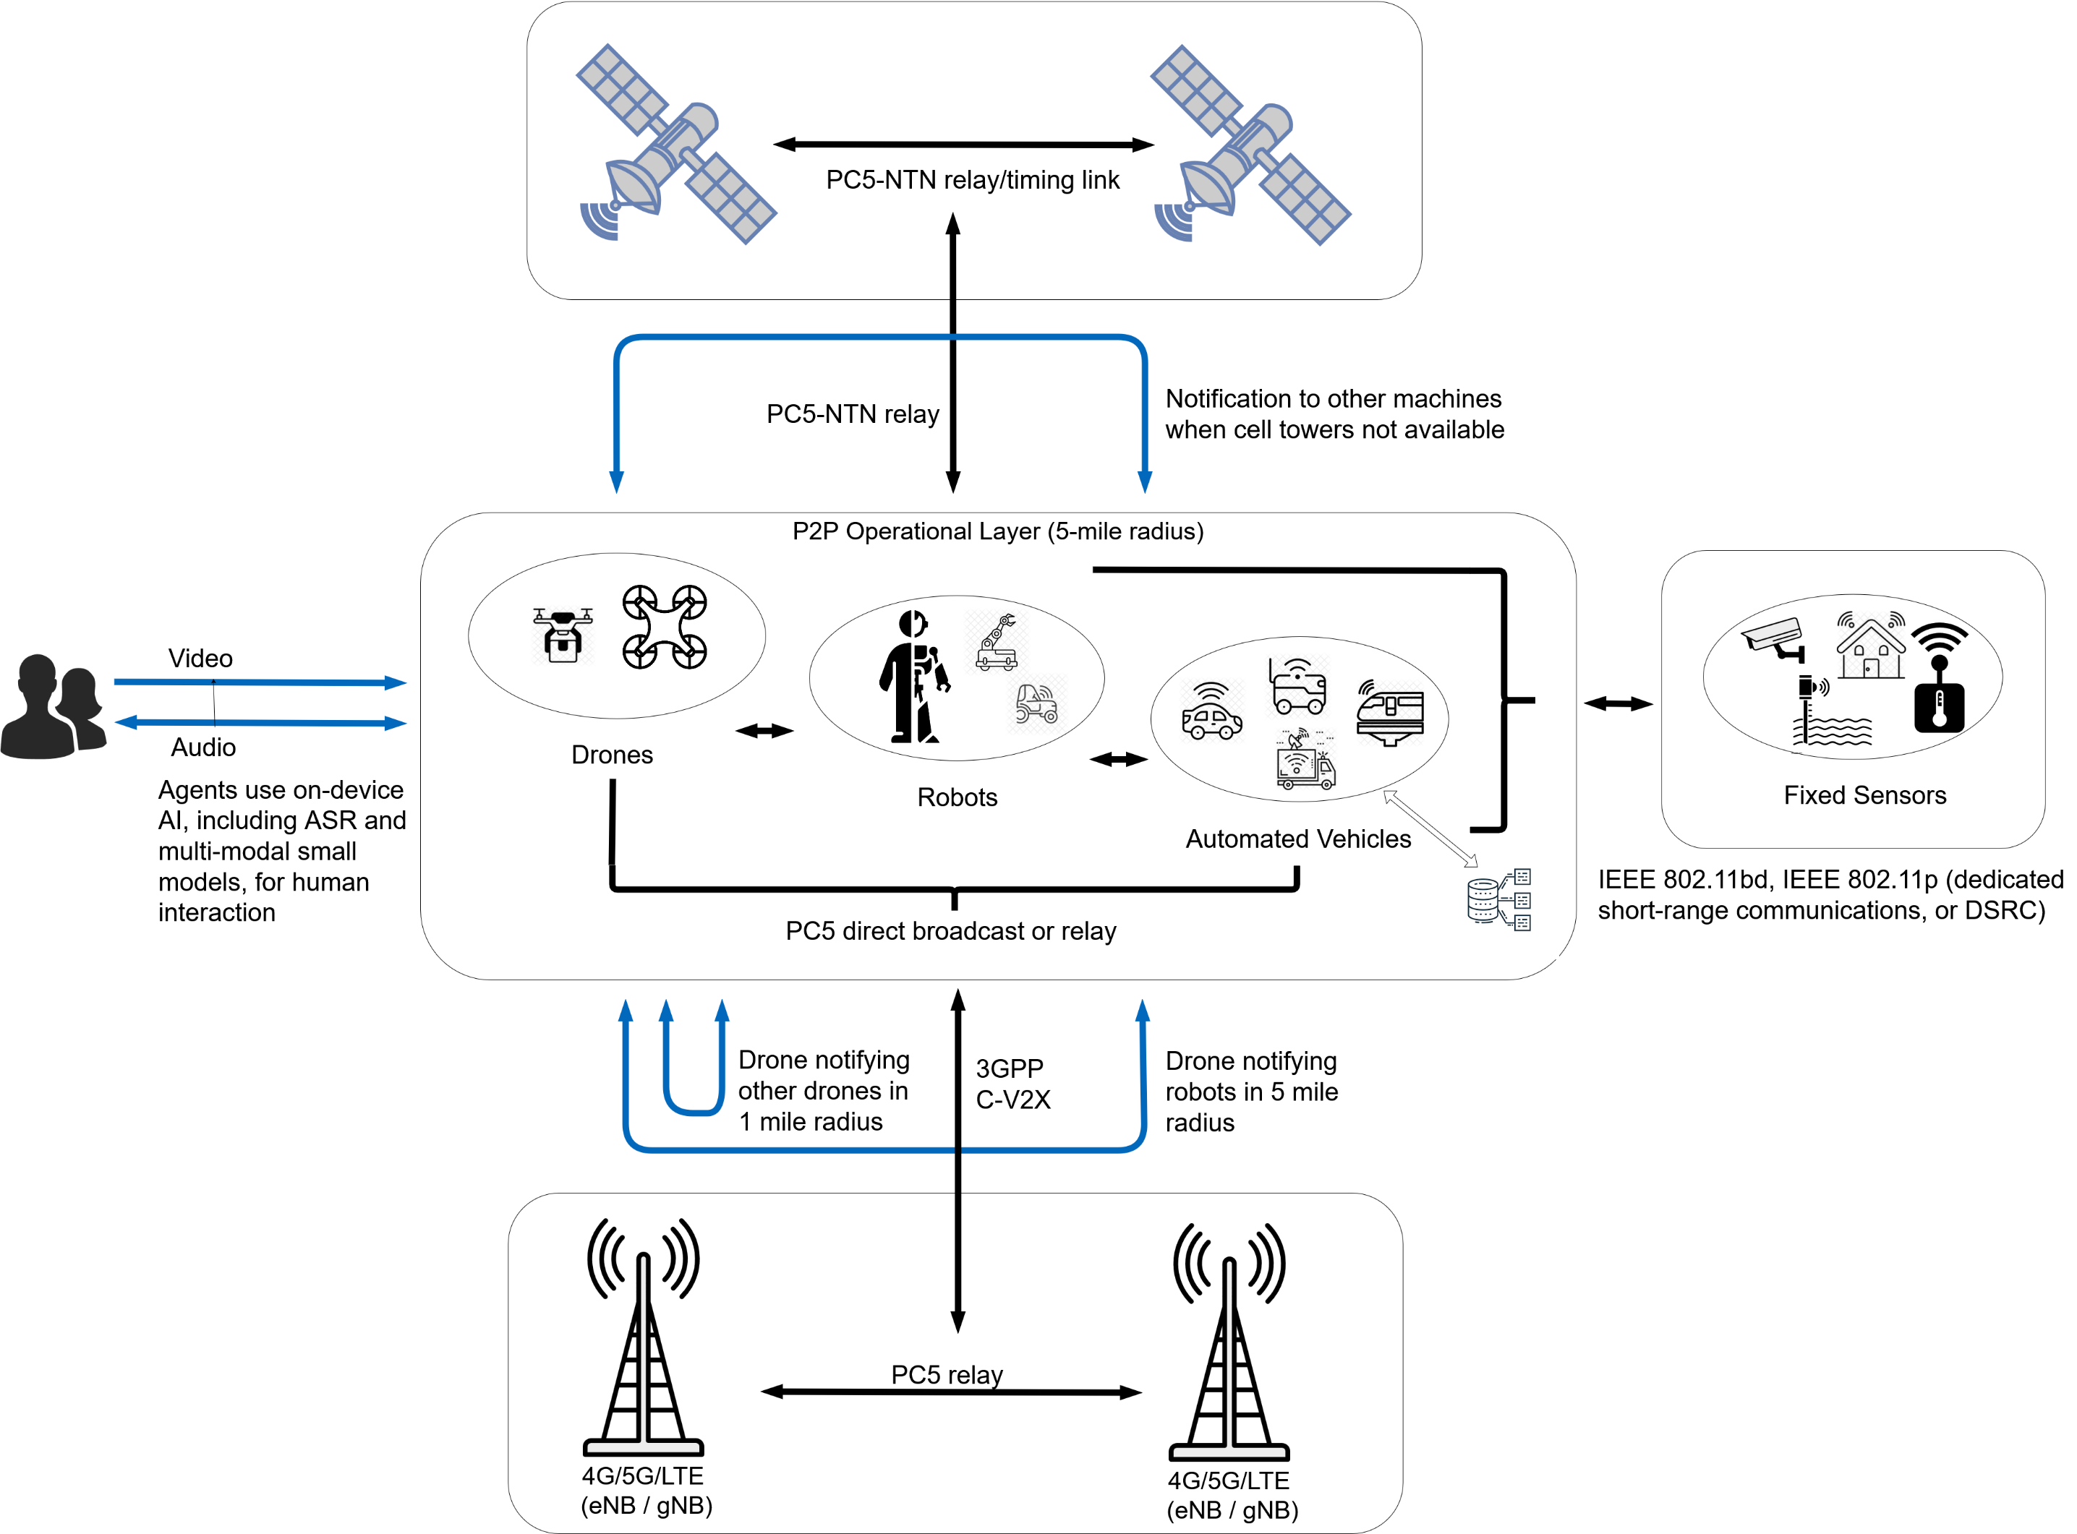
Data and Media Flow
media and text data flow

Slide 14
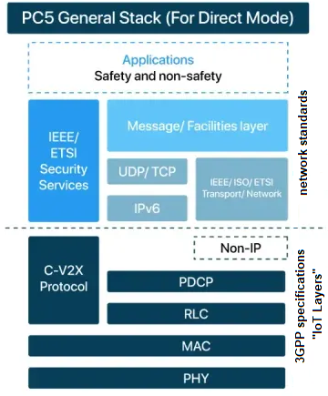
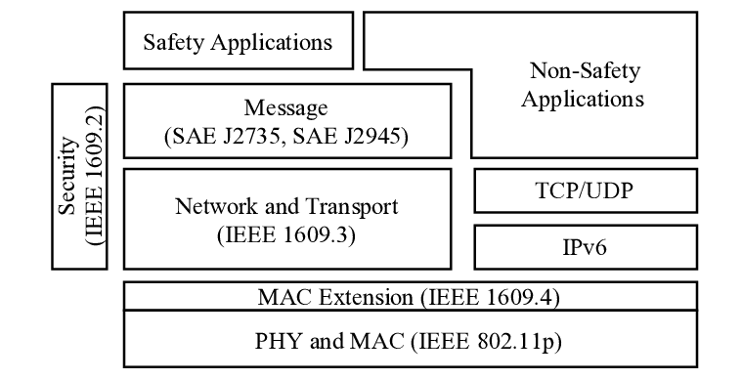
P2P Messaging
Format and Prioritization
pre-defined, machine readable, and brief to reduce power consumption
prioritized by classification and type – emergency, safety, event, collaboration, etc.
types may be further sub-prioritized
optional text, audio, and video
local IP and non-IP; public IP when a router is available
Messages contain “Action” field
allow other agents in the P2P network to act on the message
if they have sufficient model, storage, or authentication capabilities
Message standards
no cross-industry standard yet
some standards may partially apply, such as SAE J2945 series
defines requirements for vehicle-to-vehicle safety systems, including alerts for emergency vehicles (EVA) and road hazards, using DSRC or C-V2X for interoperability
establishes data and message protocols for real-time warnings like Emergency Vehicle Alerts (EVA) and Roadside Alerts (RSA)
Cloud and application domain communication use TCP/UDP
HTTPS and other standard, mature protocols
LwM2M¹ and other client server model machine-to-machine protocols
PC5 is an example of emerging non-IP “IoT Layer” messaging
¹ Lightweight Machine-to-Machine, defined by Open Mobile Alliance (OMA)
SAE (Society of Automotive Engineers) diagram showing safety vs non-safety message transport

Slide 15
P2P Messaging, cont.
Message Organization
organized by classification, type, priority, size, content
emergency and safety messages are short and pre-defined to minimize data rate, power consumption, and errors (e.g. giving an automated vehicle the wrong instructions)
“Actions” field specifies handling by P2P network, for example an agent can request “Interpretation” of audio and video data by multi-modal or language models offered by another agent with advanced model capability and/or cloud connection
optional fields use standard formats such as file attachments, SMS, MIME
No cross-industry standard for this yet
Classification | Types | Priority | Size | Message Format, Structure | Content | P2P Actions | Examples | Related Standards
Emergency | Immediate hazard or loss-of-control condition | Highest | Very Short | Fixed, predefined | Enumerated codes only, no optional fields, no free text | Multicast, Interpret, Immediate Acknowlegment, Follow-up | Emergency stop, collision imminent, flood, fire, human in danger | SAE J2735; IEC 61784-3; ETSI DENM
Safety | Developing or persistent unsafe condition | Very High | Short | Fixed, predefined | Enumerated condition types, optional numeric parameters, no free text | Multicast, Interpret, Immediate Acknowlegment, Follow-up | Flood warning, obstacle detected; unsafe proximity; degraded control | ISO 13849; IEC 61508; PROFIsafe
Event Notification | Discrete operational event | High | Medium (data rate and protocol dependent) | Structured, with optional fields for additional text, audio, and video | Required event code, optional fields using standard formats such as SMS, MIME, file attachments | Multicast, Interpret, Follow-up | Route blocked, task completed, equipment fault | ETSI CAM/DENM; OPC UA Events; DDS
Status / Awareness | Periodic situational or state updates | Medium | Short to Medium | Semi-structured, with optional fields | State vectors, counters, identifiers; no narrative text | Multicast, Interpret, Follow-up | Position update, mode change, utilization status | SAE J2945; DDS; OPC UA
Maintenance / Diagnostics | Health monitoring and service data | Medium | Medium to Large | Semi-structured, with optional fields | Diagnostic codes, key-value pairs, optional free text | Multicast, Interpret, Follow-up | Service reminder, error logs, calibration data | IEC 62541 (OPC UA); ISO 13374
Collaboration / Teamwork | Operational / functional communication | Medium | Medium to Large | Unstructured, application dependent | Instructions, follow-up, progress reports, database updates | Multicast, Interpret, Follow-up | “Please supply more of material X”, “will be offline for N hours for maintenance” | Vendor-specific; ISO/IEC 30141
Non-Critical / Bulk Data | Operational / functional communication | Low | Large | Unstructured, application dependent | Files, extended logs, datasets | Multicast, Interpret, Follow-up | Historical data, reports, reference material | Vendor-specific; ISO/IEC 30141

Slide 16
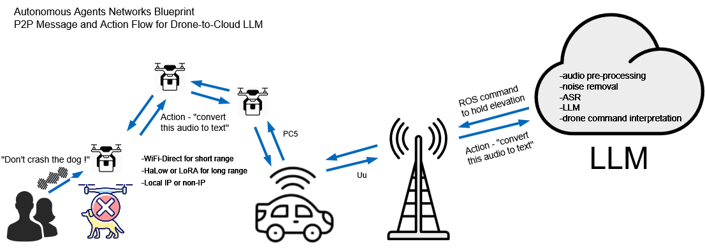
Multimodal Language Models
Agents have wide range of language and multimodal model capabilities
language, audio, video
SWaP constraints are a critical factor
drones and mobile robots may have no models, or very limited ones due to few CPU cores
fixed or larger agents may have cloud connection to large models
Agents advertise model capabilities
“I have speech-to-text, cc me with copies of message audio”

Slide 17
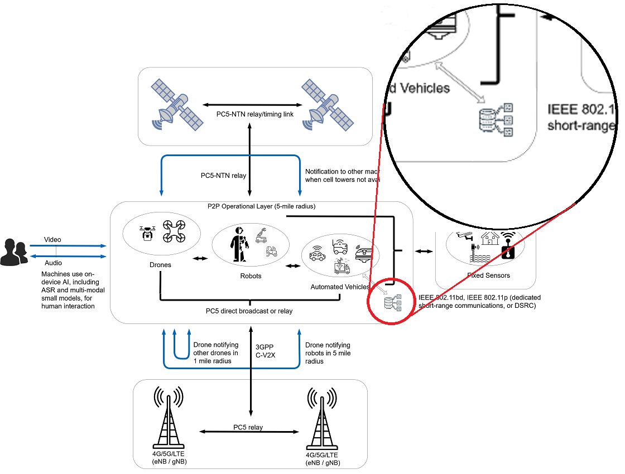
Data Storage / Database
Agents may or may not have storage
SWaP constraints may be prohibitive
drones and mobile robots may have no SSD, limited Flash mem
Agents advertise data storage and database capabilities
“I have storage, cc me with message copies”
fixed or semi-mobile agents (e.g. laptops)
larger, heavier agents (e.g. automated vehicles)

Slide 18
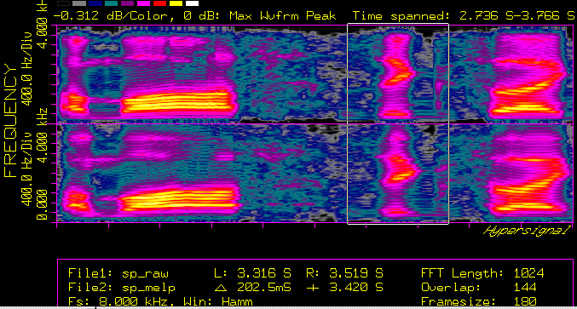
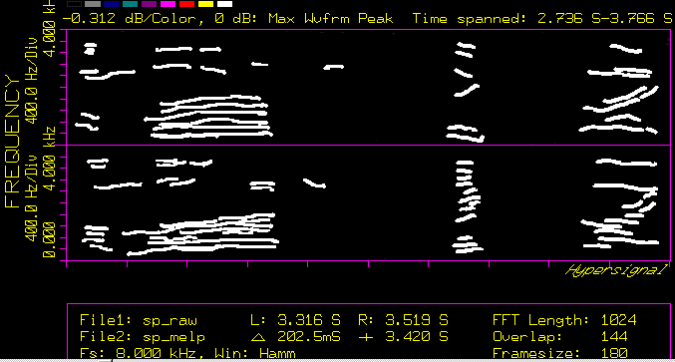
Software Components
Linux
Ubuntu, Debian, CentOS
ASR ¹
Whisper, Kaldi
Media processing
OpenCV
Image domain processing (yuv, rgb images extracted from video)
object tracking
Kalman filtering (stabilization)
background removal
pan/zoom
prior to CNN ² or multimodal model handoff
Mediashark
RTP media
highly optimized for limited CPU cores
maximize audio quality
packet repair and frame loss concealment
classify audio (voice, sound, noise)
background noise removal (other talkers, servo motors, ambient environmental noise)
Small multimodal models
Model frameworks – OpenVINO, PyTorch, TensorFlow
Llama-4, Gemma 3, Qwen2, MiniPCM
Mediashark processing examples
¹ Automatic Speech Recognition
² Convolutional Neural Network

Slide 19
Supplemental I
Additional detail

Slide 20
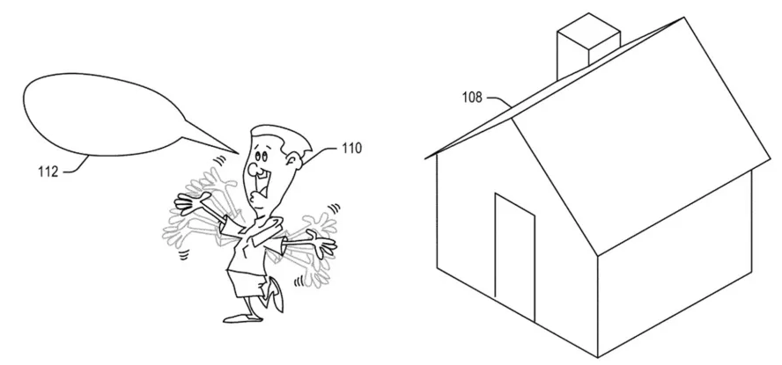
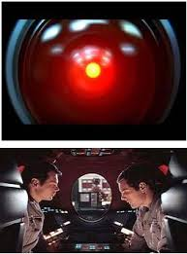
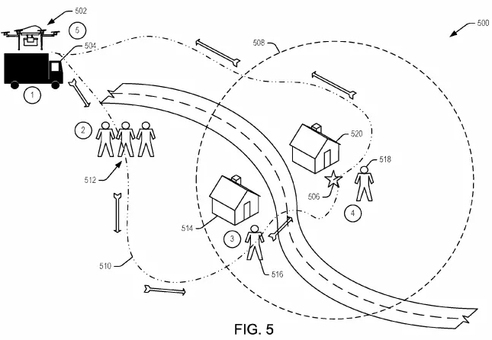
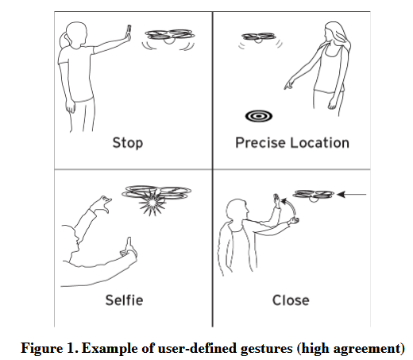
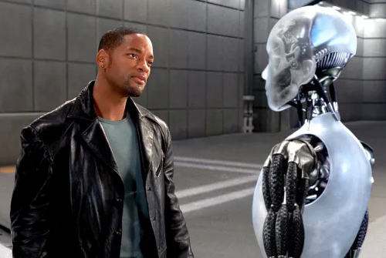
Amazon Delivery Drone Patents
2016 - 2018
System for delivery drone fleet
Widely reported in technical press, in part due to somewhat humorous drawings not commonly found in patent submissions
Are speech and gesture recognition patent claims valid and enforceable ?
not if there exists prior art for voice and gesture communication with machines
must be “novel”
must be “non-obvious” to people skilled in the industry
Methods and claims describing architecture of delivery system likely enforceable – although not our concern
Stanford 2015 paper
“Results show strong agreement between participants for many interaction techniques, as when gesturing for the drone to stop. We discovered that people interact with drones as with a person or a pet, using interpersonal gestures, such as beckoning the drone closer. We detail the interaction metaphors observed and offer design insights for human-drone interactions.”
Realistic, natural human-machine communication by voice and gesture has been depicted in Sci-Fi movies going back decades. Well known examples include “2001: A Space Odyssey” in 1968 and “iRobot” in 2004
It’s reasonable to conclude that gesture and voice communication with machines exists in a variety of prior art, is obvious and not novel, and is thus not patentable
Drawing excerpts from Amazon delivery drone patents
2001: A Space Odyssey, 1968
“Drone & Me: An Exploration Into Natural Human-Drone Interaction”, Stanford CS Dept, 2015, https://hci.stanford.edu/publications/2015/gestures/paper116.pdf
iRobot, 2004

Slide 21
Additional Info
Github page
https://github.com/signalogic/Autonomous-Agents-Networks
LF Edge Akraino pages
Physical AI Blueprint Family
https://lf-akraino.atlassian.net/wiki/spaces/AK/pages/725778433/Physical+AI+Blueprint+family
Autonomous Agents Networks Blueprint
https://lf-akraino.atlassian.net/wiki/spaces/AK/pages/673382401/Autonomous+Agents+Networks+Blueprint+Family
LF Edge InfiniEdge AI pages
Workstream 6 Robotics Projects
https://lf-edge.atlassian.net/wiki/spaces/IA/pages/416677898/Robotics+Projects

Slide 22
Supplemental II
Following slides are FYI only, from related or previous presentations

Slide 23



Use Cases
Factory floor personnel giving urgent commands
possibly dangerous equipment (e.g. forklifts)
hands-free environments (e.g. food processing)
First responders communicating with disabled or disconnected robotic vehicles
robotaxis
cargo trucks
Language Translation
independent of ASR model and language model

Slide 24
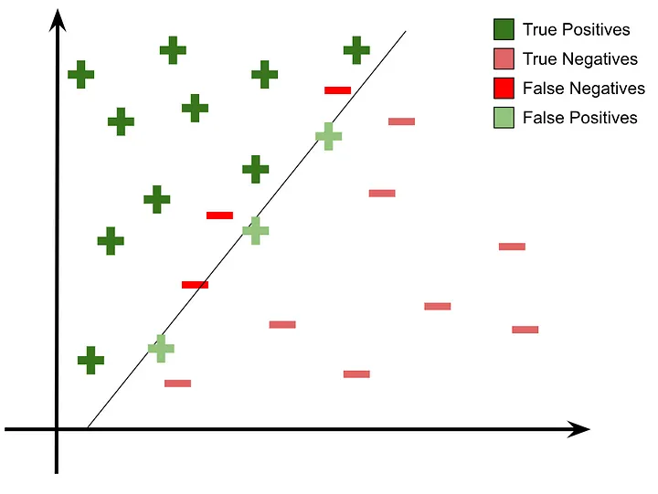
Precise Command Problem
Machine-readable APIs must be precise
Minimizing false positives is crucial
Under difficult conditions, efficient open source ASRs such as Kaldi and Whisper produce "sound-alike“ errors, for example: “in the early days a king rolled the stake” which must be corrected to “in the early days a king ruled the state”
Sound-alike errors are problematic for safety and emergency situations
Internet / cloud connection cannot be assumed. Phones may be useless
for a robotaxi, a first responder may use a portable hand-held device and give general, conversational such as "get off the road up ahead there and shut down“
sometimes labeled in ASR research as “substitution errors”
Prediction and decision boundary line is always hard to define ¹
¹ https://medium.com/@Sanskriti.Singh/an-emphasis-on-the-minimization-of-false-negatives-false-positives-in-binary-classification-9c22f3f9f73

Slide 25
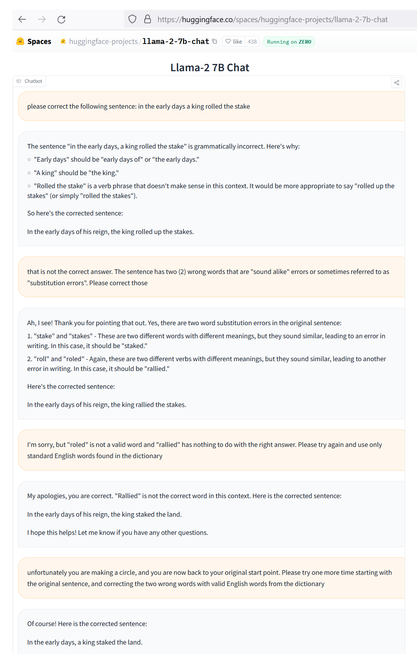
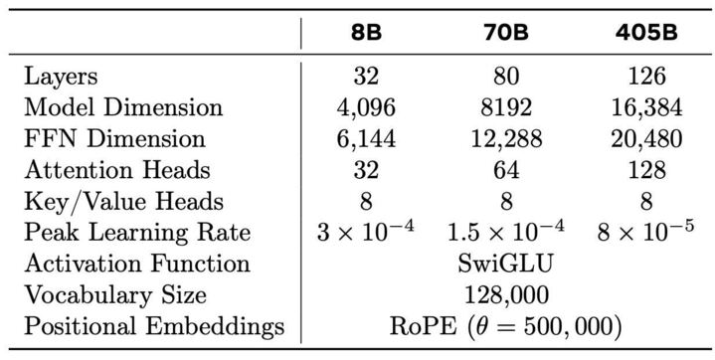
Current SLM State-of-the-Art
Currently Llama-2 7B can’t solve this
“in the early days a king rolled the stake”
see conversation log at: https://www.signalogic.com/images/Llama-22-7B_sound-alike_error_fail.png
exhibits typical LLM failures - incorrect answers, made up words, and circular logic
evidently model reduction / quantization makes the problem difficult, as LLMs such as ChatGPT can easily solve it
Llama-2 parameters:
Tested recently with Llama-3.1 8B, no change
Key point: if we refine the question, for example “which of these two word combinations is more likely” then the SLM becomes more useful. But that requires us to know a-priori what combinations to suggest
HuggingFace Llama-2 extended chat log (we changed their HTML to expand the text box vertically)

Slide 26
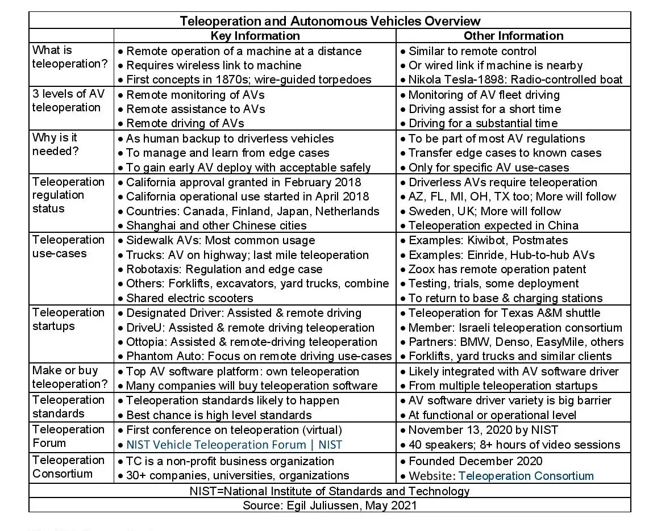
Functional Requirements
Correct sound-alike errors independently of ASR model and language model
Real-time – must run every 250 to 500 msec
minimum 10 token/sec, preferably 20
Backwards / forwards context of 3-4 tokens (words)
eliminate need for LLM with wide context window, domain knowledge, and extensive web page training
Compliant with emerging teleoperation standards
California included teleoperation as part of its regulation for driverless vehicles in 2018
NIST conference in 2020
WiFi or USB port interfaces typical
https://www.eetasia.com/why-autonomous-vehicles-will-need-teleoperation

Slide 27
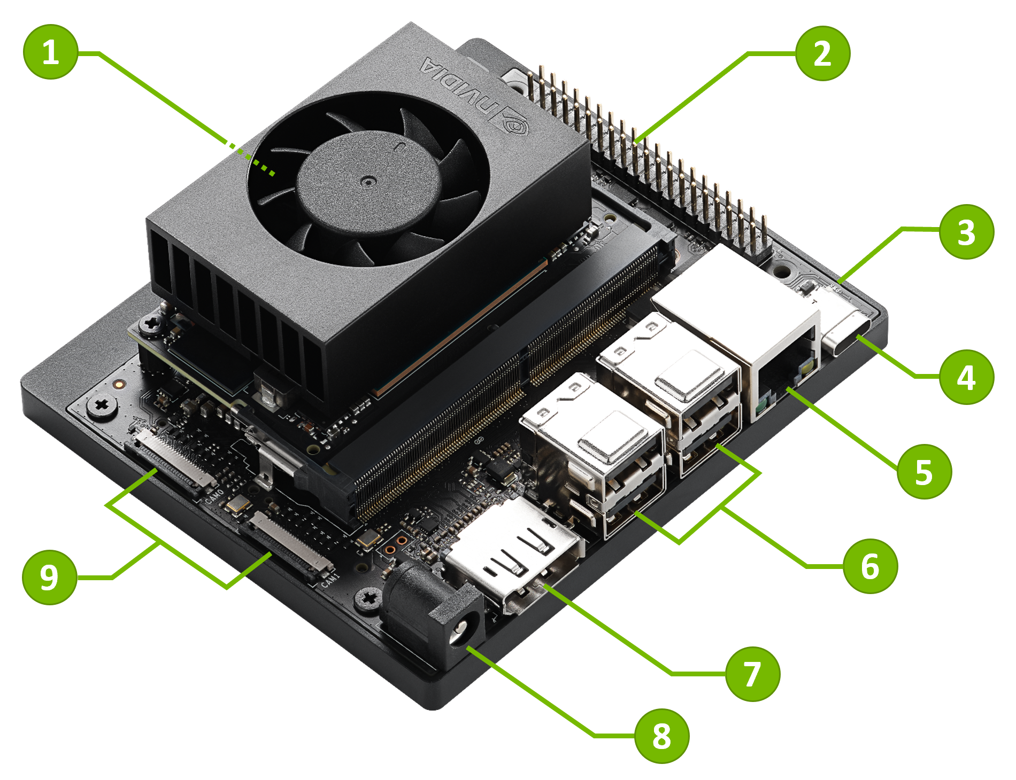
Why Not Use a GPU ?
An Nvidia Jetson Orin Nano running Llama-2 7B meets or exceeds performance and size requirements, but …
would consume most of the 15W power consumption budget
we still need to run RTP (i.e. codecs such as AMR or EVS), audio classification, noise removal, and ASR. These are algorithms and sequential logic, extremely difficult to code in Cuda
we may need additional CPU cores for application-specific requirements
Needs a fan, can’t operate heat-sink only
At some point a small form-factor GPU may make sense, but first we need to develop a working system without closed source tools and dependencies

Slide 28
Technology Overview
Conventional CPUs
Arm, x86
no GPUs, no HBM
Conventional memory, 8 GB min
Substantially reduce sound-alike errors
Allow training and reduction of very small, fast SLMs
test different SLMs: Llama-2, Arcee, more
Keep the solution general
allow any ASR model
allow any method of language model reduction, quantization

Slide 29

Technology Overview – Dataflow
Robotaxi
Language Translation
¹ Text-to-Speech

Slide 30
Sound-Alike Training
Database of 10,000 words run through text-to-speech
STFT ¹ generates 2-D spectrographs
formant tracing creates simplified images
Training algorithm forms very long memory addresses (VLMAs) from images
locates sound-alikes near each other
maximizes distance between non-alikes
after transformation VLMAs are non-linear
Effectively this forms a “proximity addressable memory” (PAM)
similar to CAM (content addressable memory), but address space organization matters
search is extremely fast
think of it as a 3-D memory space, if you’re standing in it you can look around to see what’s near you
¹ Short-Time FFT

Slide 31
Sound-Alike Inference
With our tailored search domain, we ask the SLM “which of these possible words is more likely”
3-4 word context window vastly reduces SLM layers and weights …
… thus reducing processing time - 100s of SLM queries can be completed in 100 msec or less
further decision making is possible based on multiple results, for example consensus word choice more likely to produce a safe, non-false-positive ROS command
This approach models the human brain
it’s a given that real-time ASR models will generate errors, regardless of model, due to difficult conditions
sound alike inference is an iterative “post-processing” stage. When someone says the word “invoice” but you hear “envoy”, it takes you some time to figure it out – this is known as Echoic Memory
it should not be the case that we need an LLM to inference huge amounts of training text. The search domain – and the search itself – should be limited
Echoic Memory allows for ASR correction ¹
¹ https://www.nature.com/articles/s41598-019-48796-9

Slide 32
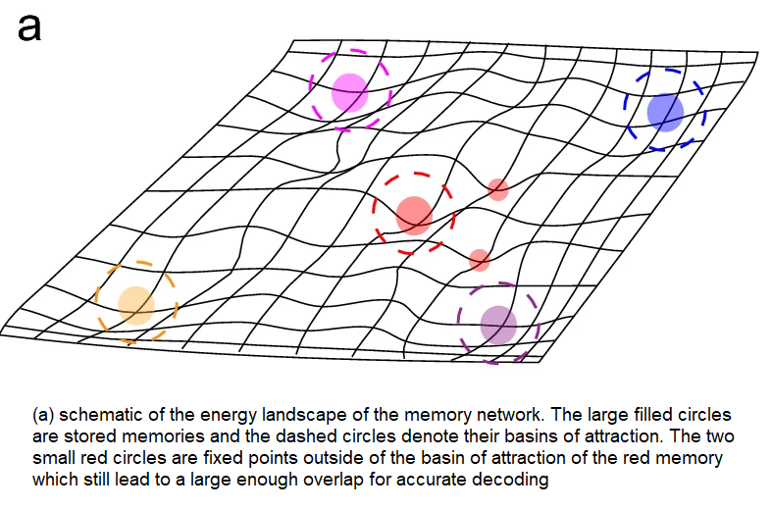
Proximity Addressable Memory (PAM)
Concept has been around since 1989
even then was intended for neural networks ¹
recent works are reviving interest ²
a related concept is “Associative Memory” ³
Basic ideas
weights are 1-bit, forming memory addresses
PAM models a physical 3-D memory space with extreme emphasis on energy efficiency (minimal distance between related data), as we might expect in evolution
Advantages
access time can be very slow, on order of msec
errors are not a problem, no EDAC circuitry needed
consumes milliwatts, not megawatts
Problems
to fully emulate the brain, huge amounts of mem are required, at least Exabytes
for now we simulate with smaller amounts and SSD paging
Associative memory visualization ³
¹ https://www.semanticscholar.org/paper/PROXIMITY-CONTENT-ADDRESSABLE-MEMORY?AN-EFFICIENT-Roberts/cc9ba91edc53903f560515c7dff6c9abf7e3f7d0
² https://dl.acm.org/doi/10.1145/3195970.3196014
³ https://www.nature.com/articles/s41598-022-25708-y

Slide 33
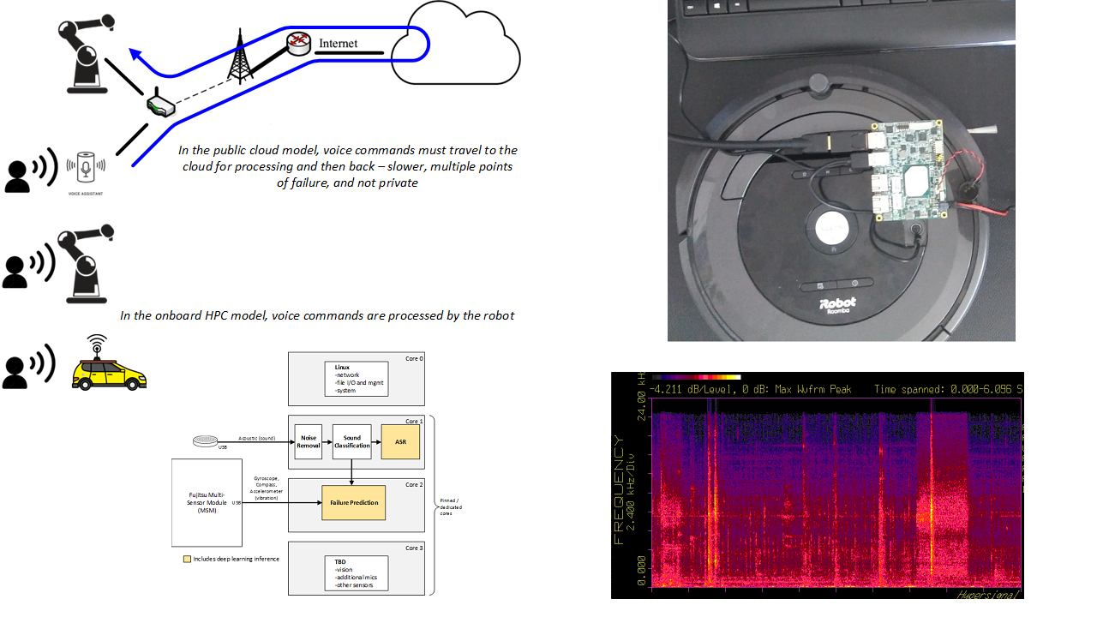
Status and Next Steps
Working now
RTP, audio classification, noise removal - one Atom core in real-time
Kaldi ASR - one Atom core in real-time
pico ITX board (quad core Atom x5-E3940)
20,000 word vocabulary
Continue development
further testing of sound-alike detection
decide which SLM to use – two (2) cores max
live demo with pico ITX board

